Slide 1
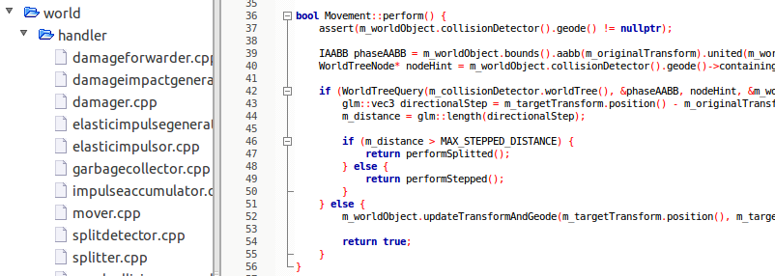
Engine
From-scratch-engine managing:
Physics
CollisionDetection
Damage
Splitting
24.03.2013
Gameprogramming 2013 - Voxellancer
<number>

Slide 2
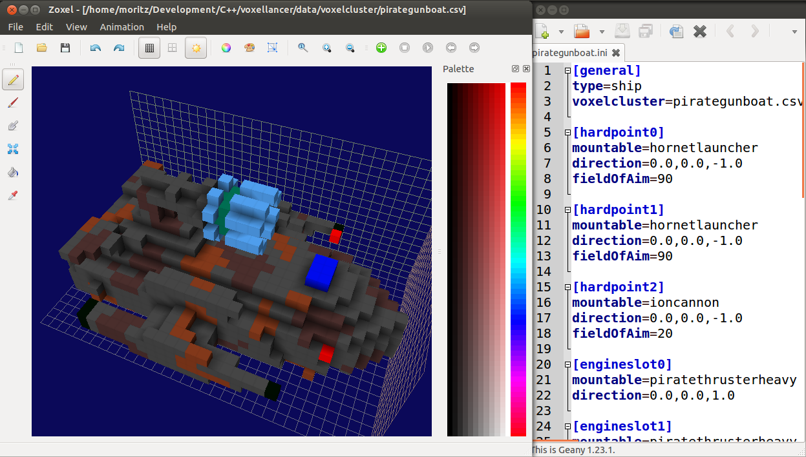
Moddeling
24.03.2013
Gameprogramming 2013 - Voxellancer
<number>

Slide 3
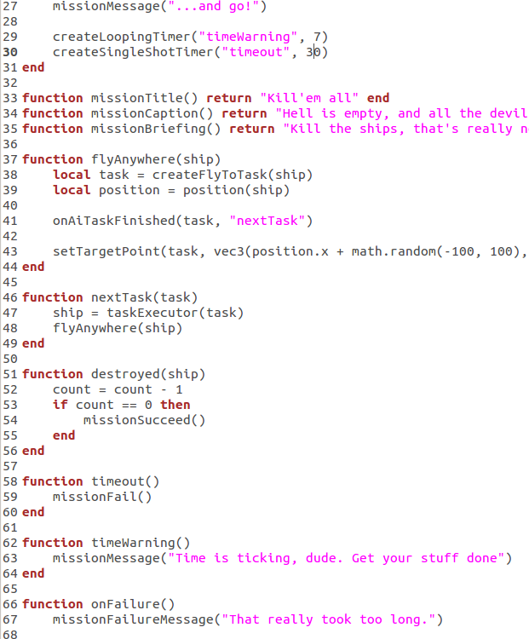
Scripting
24.03.2013
Gameprogramming 2013 - Voxellancer
<number>

Slide 4
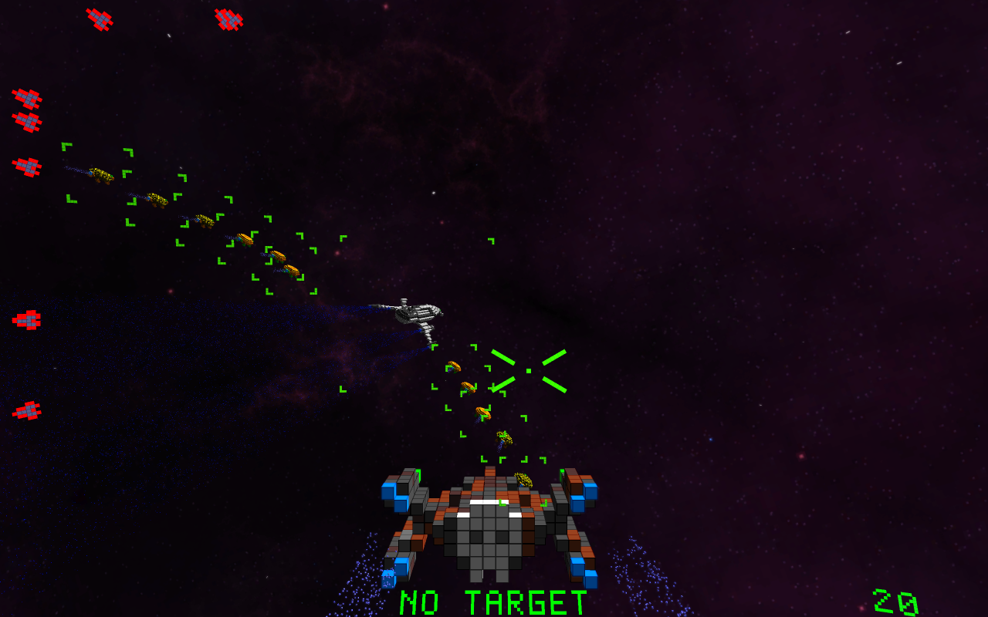
AI and Squads
24.03.2013
Gameprogramming 2013 - Voxellancer
<number>

Slide 5
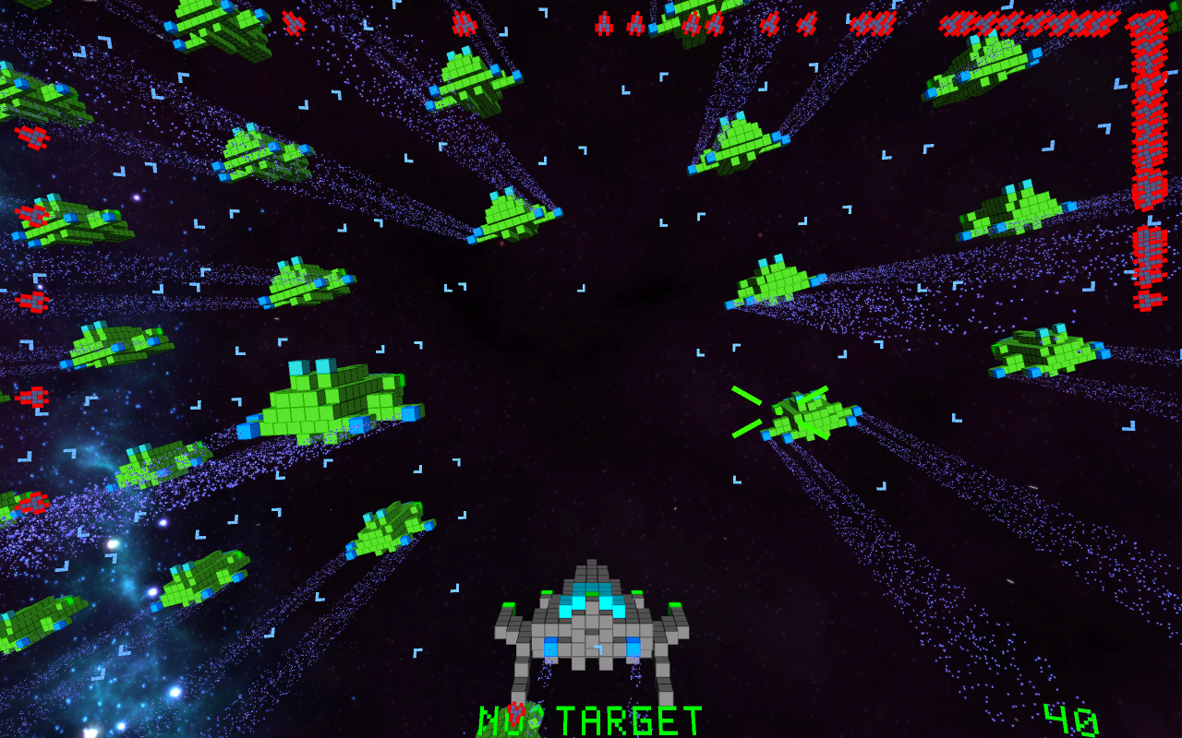
ParticleEngine and Effects
24.03.2013
Gameprogramming 2013 - Voxellancer
<number>

Slide 6
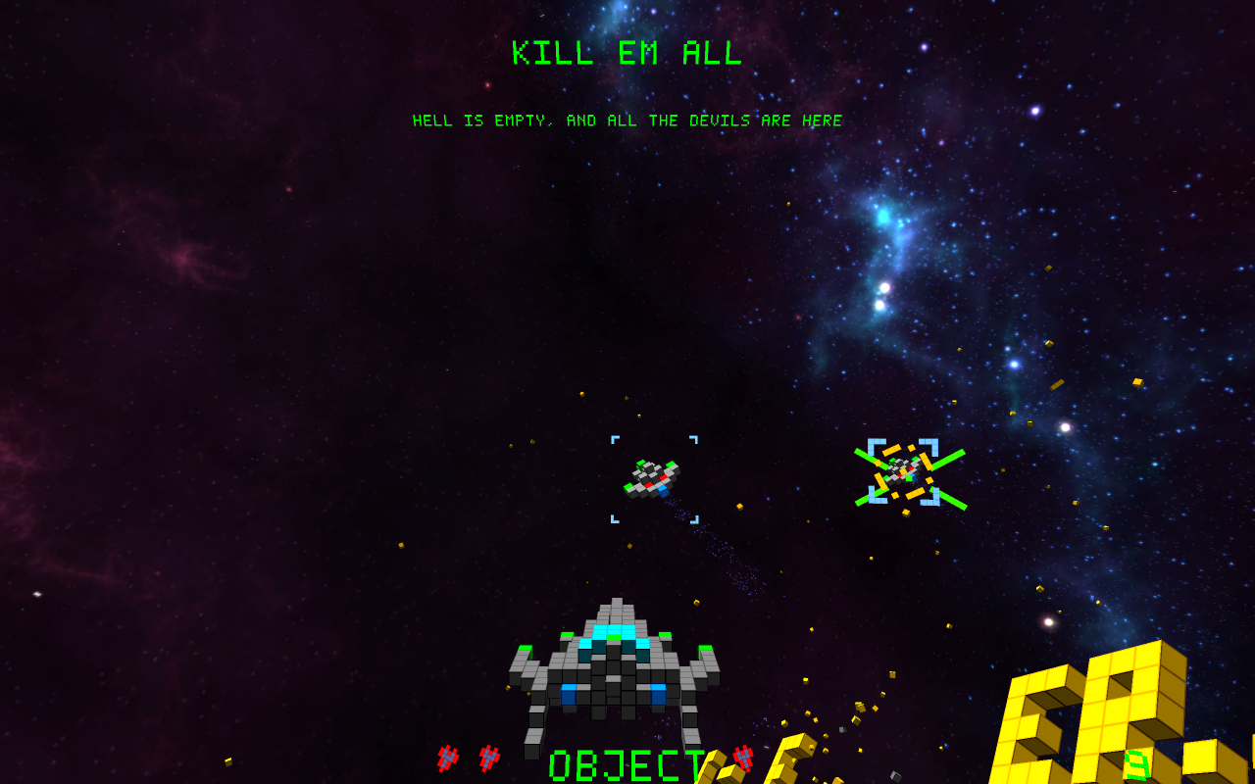
HUD
24.03.2013
Gameprogramming 2013 - Voxellancer
<number>

Slide 7
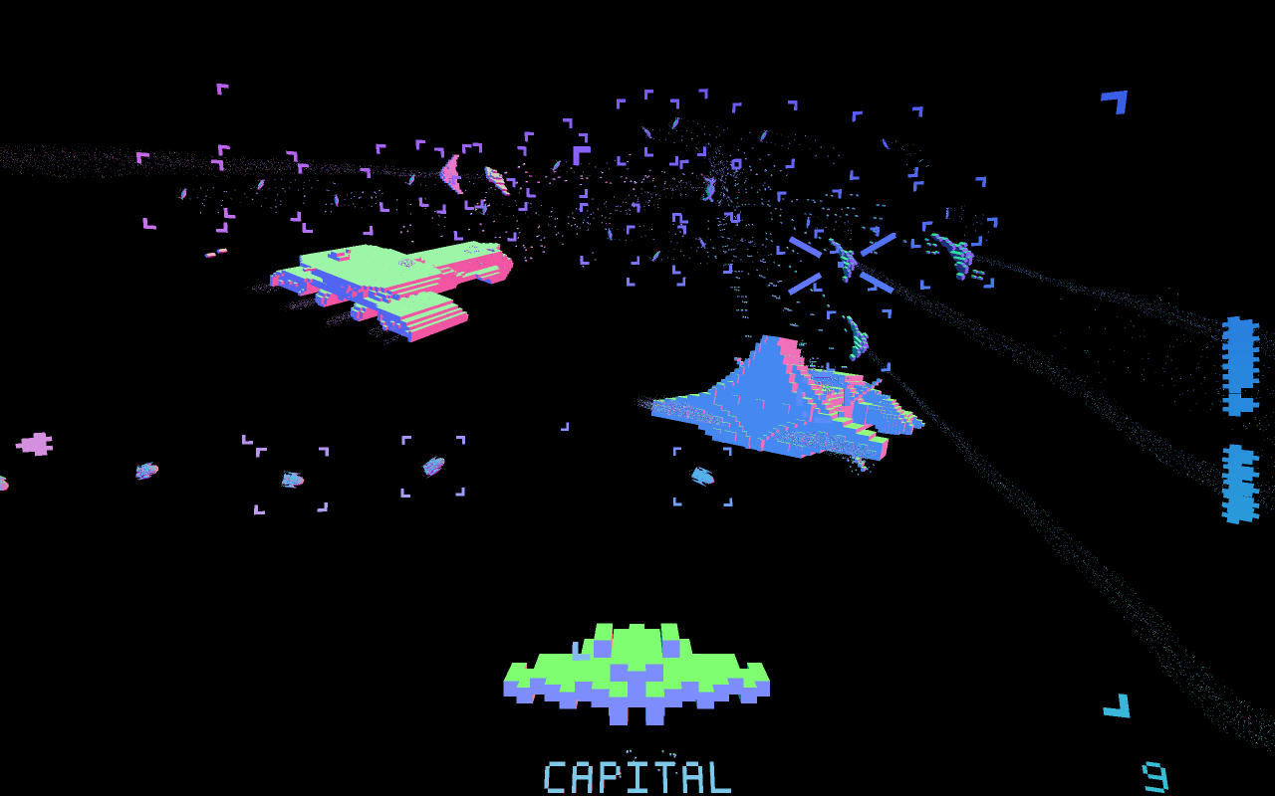
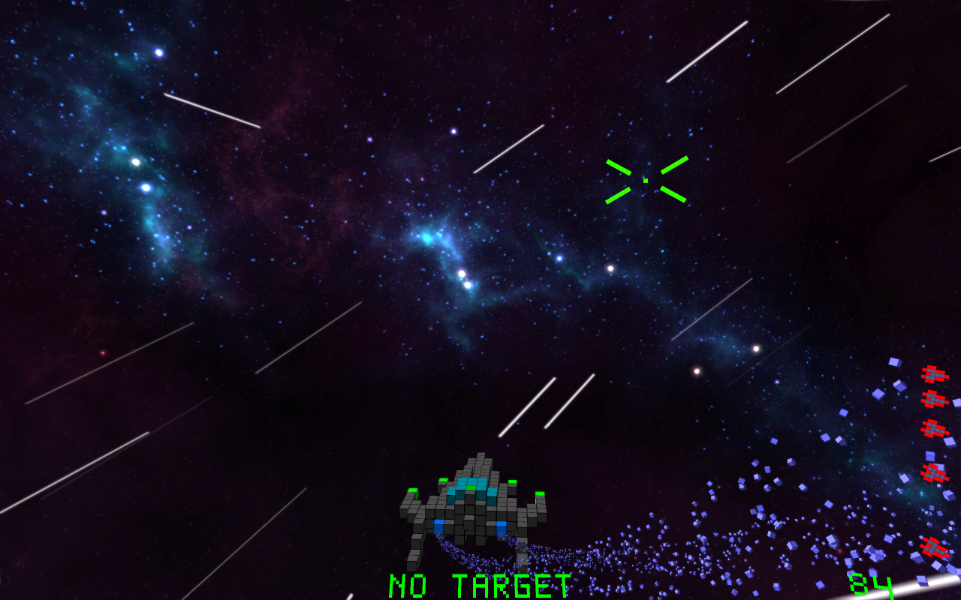
Postprocessing
24.03.2013
Gameprogramming 2013 - Voxellancer
<number>

Slide 8
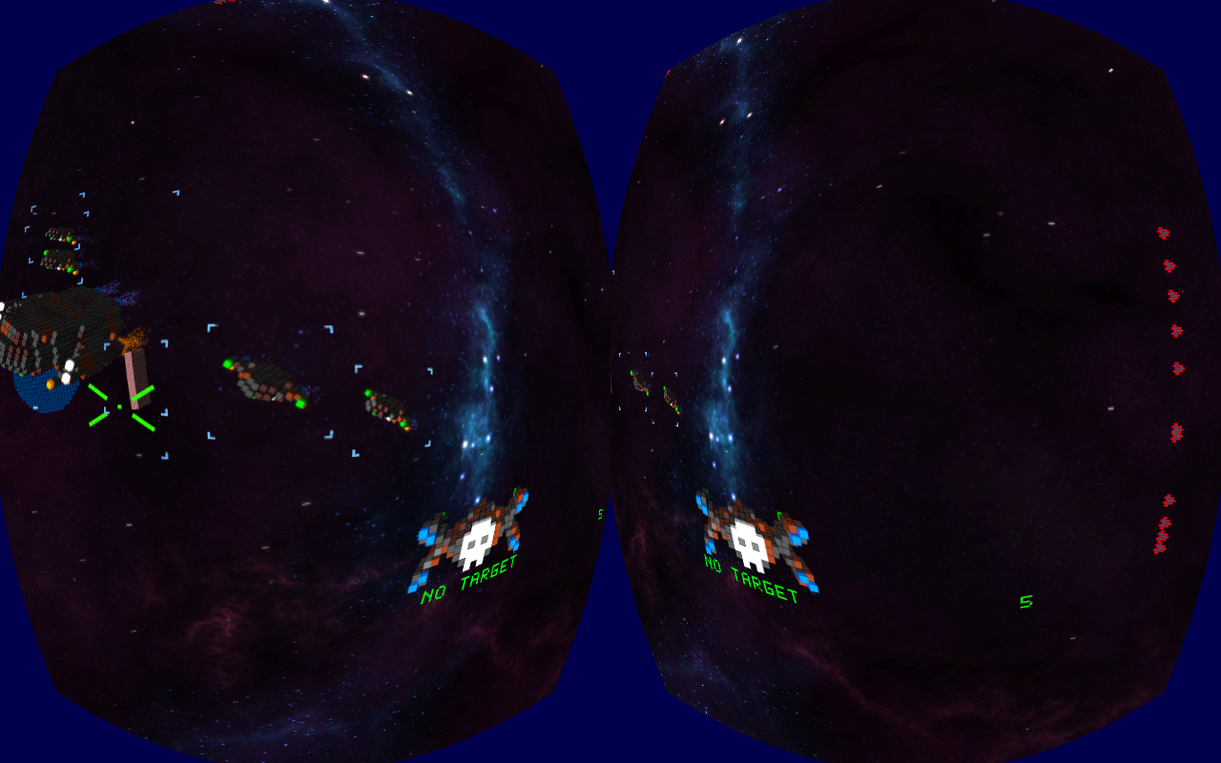
Oculus Rift
24.03.2013
Gameprogramming 2013 - Voxellancer
<number>

Slide 9
Misc.
3D Audio (engine-sound, explosions...)
Factions
Configureable Gamepad and Joystick support
Equipment, i.e. Weapons and Engines are changeable
Homing missiles
...
24.03.2013
Gameprogramming 2013 - Voxellancer
<number>

